Slide 1
ITCS 4152/5152
Computer Vision
Dog Breed Image Classification

Slide 2
Group 5
Anas Ibrahim, Ben La Rocca, Duy Minh Pham, Raymond Nguyen, Zachary Pacello

Slide 3
01
Problem/Motivation

Slide 4
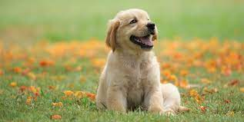
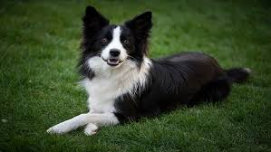
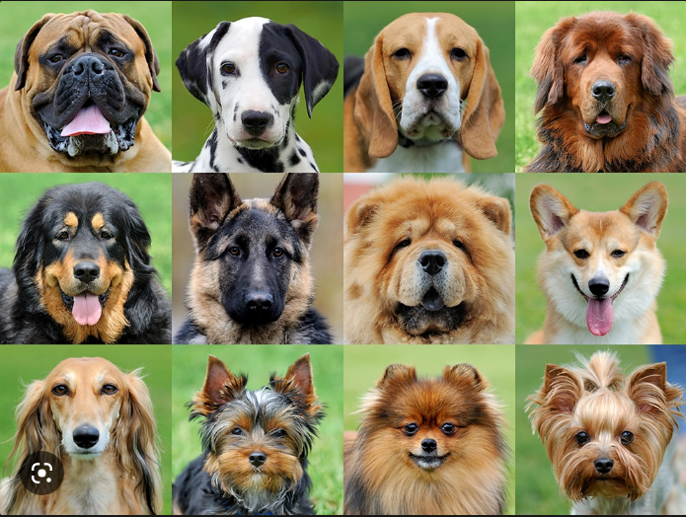
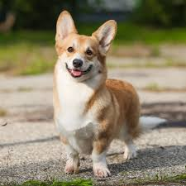
Problem
Improving the accuracy of an existing pre-trained machine learning model for classifying dog breeds from images

Slide 5
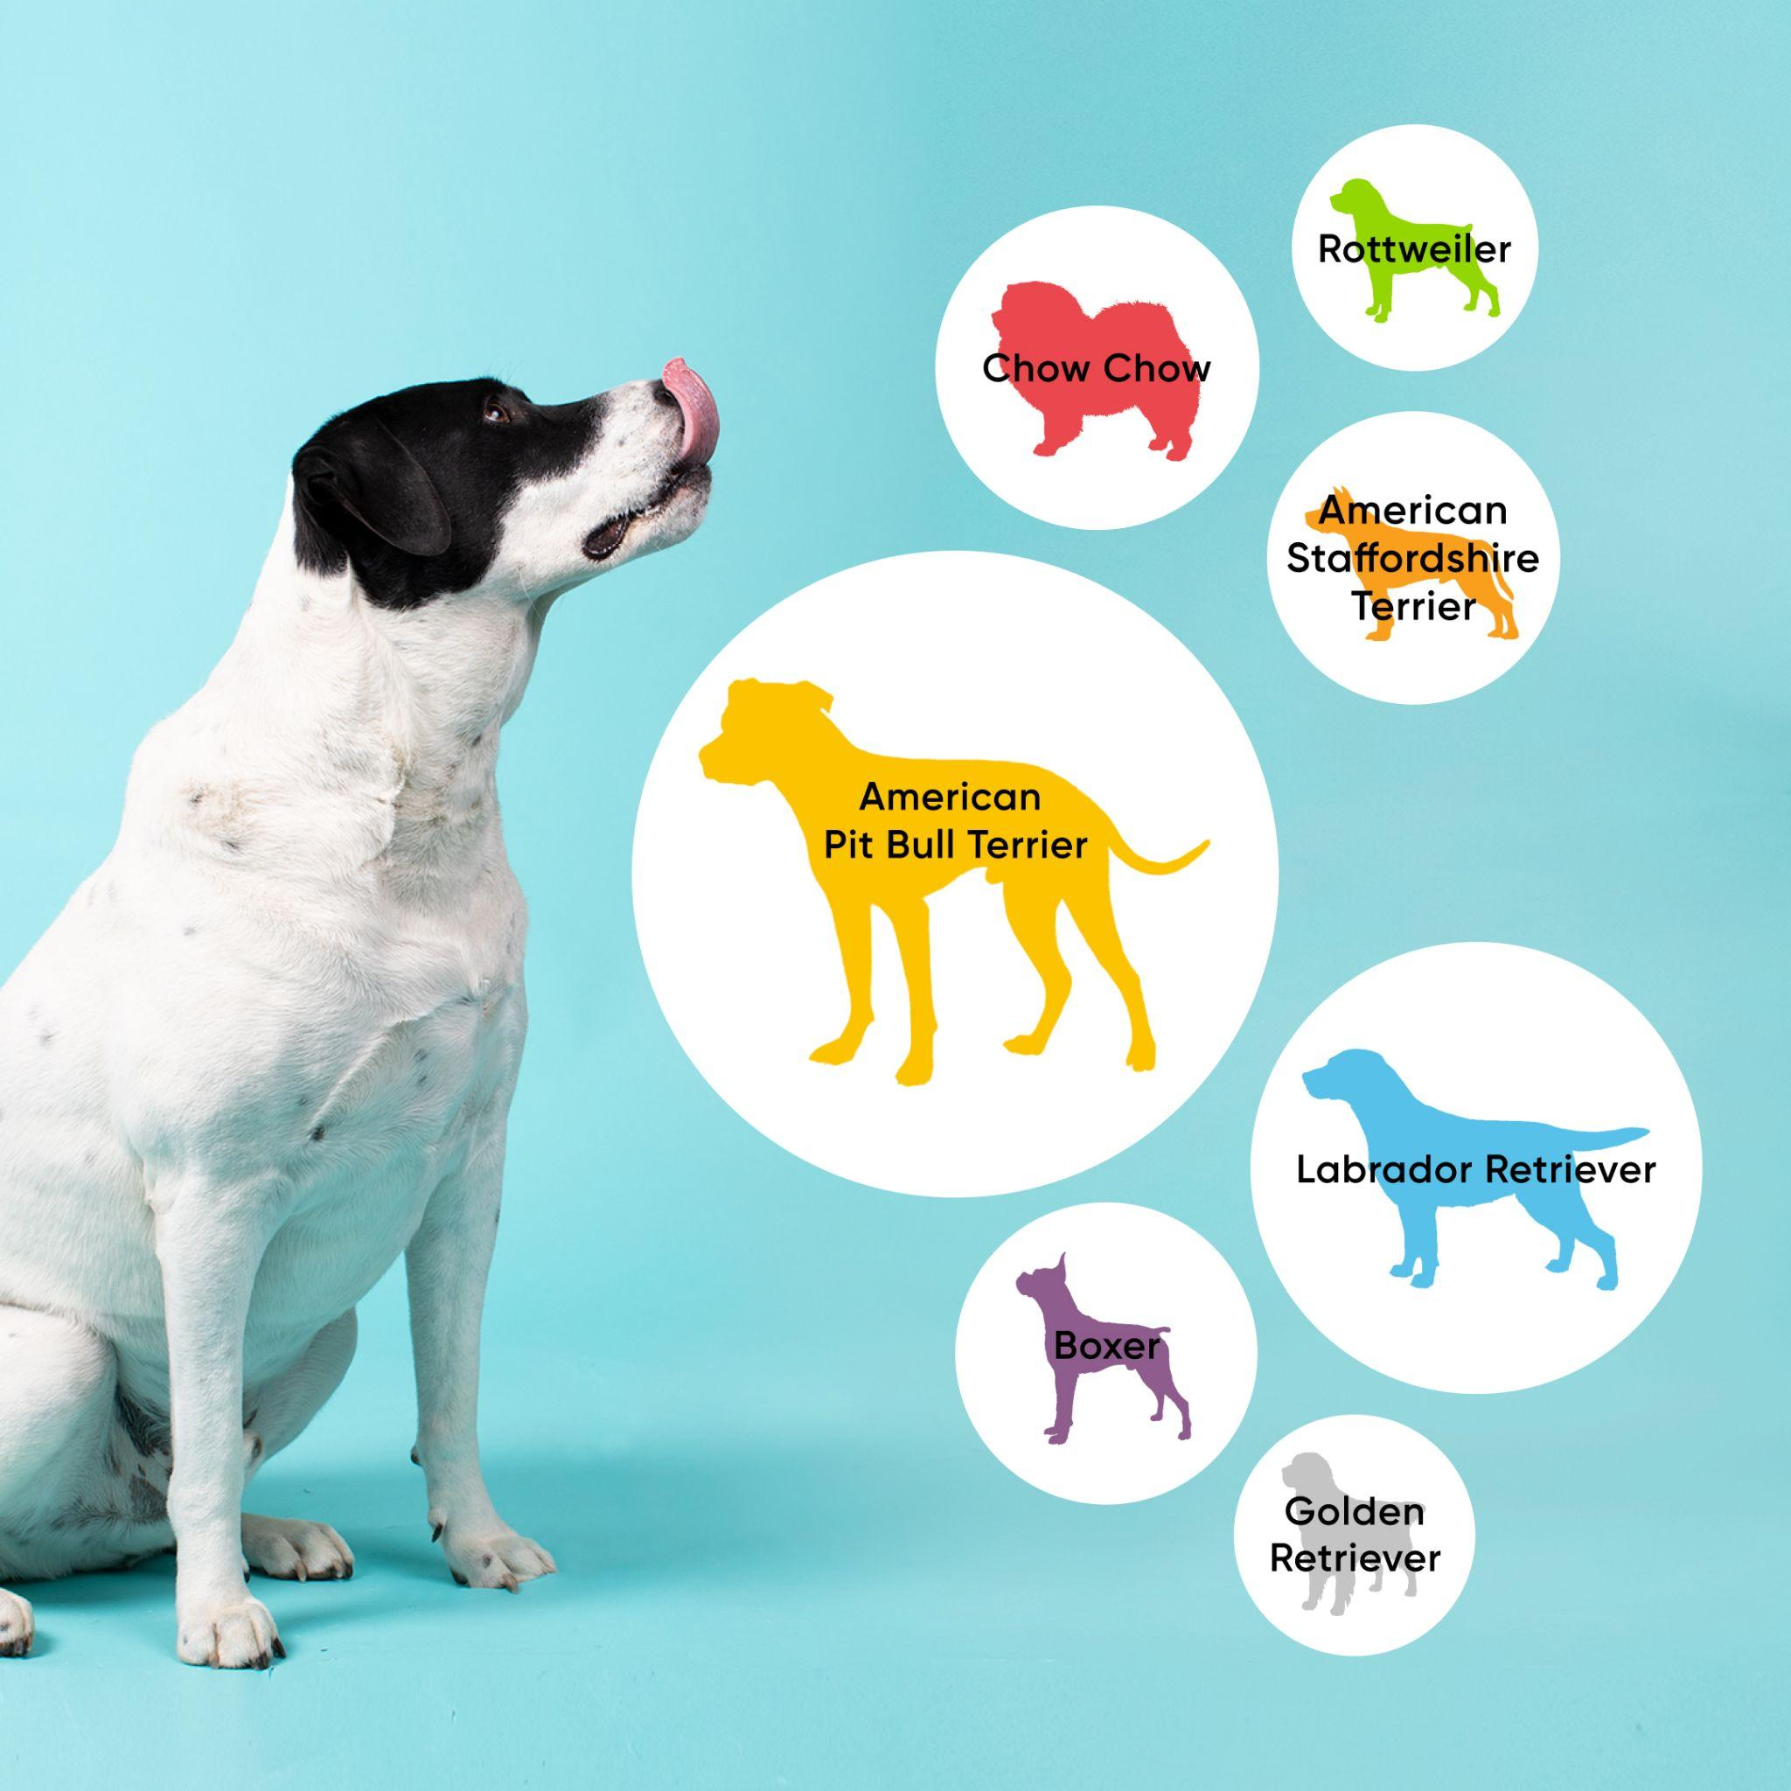

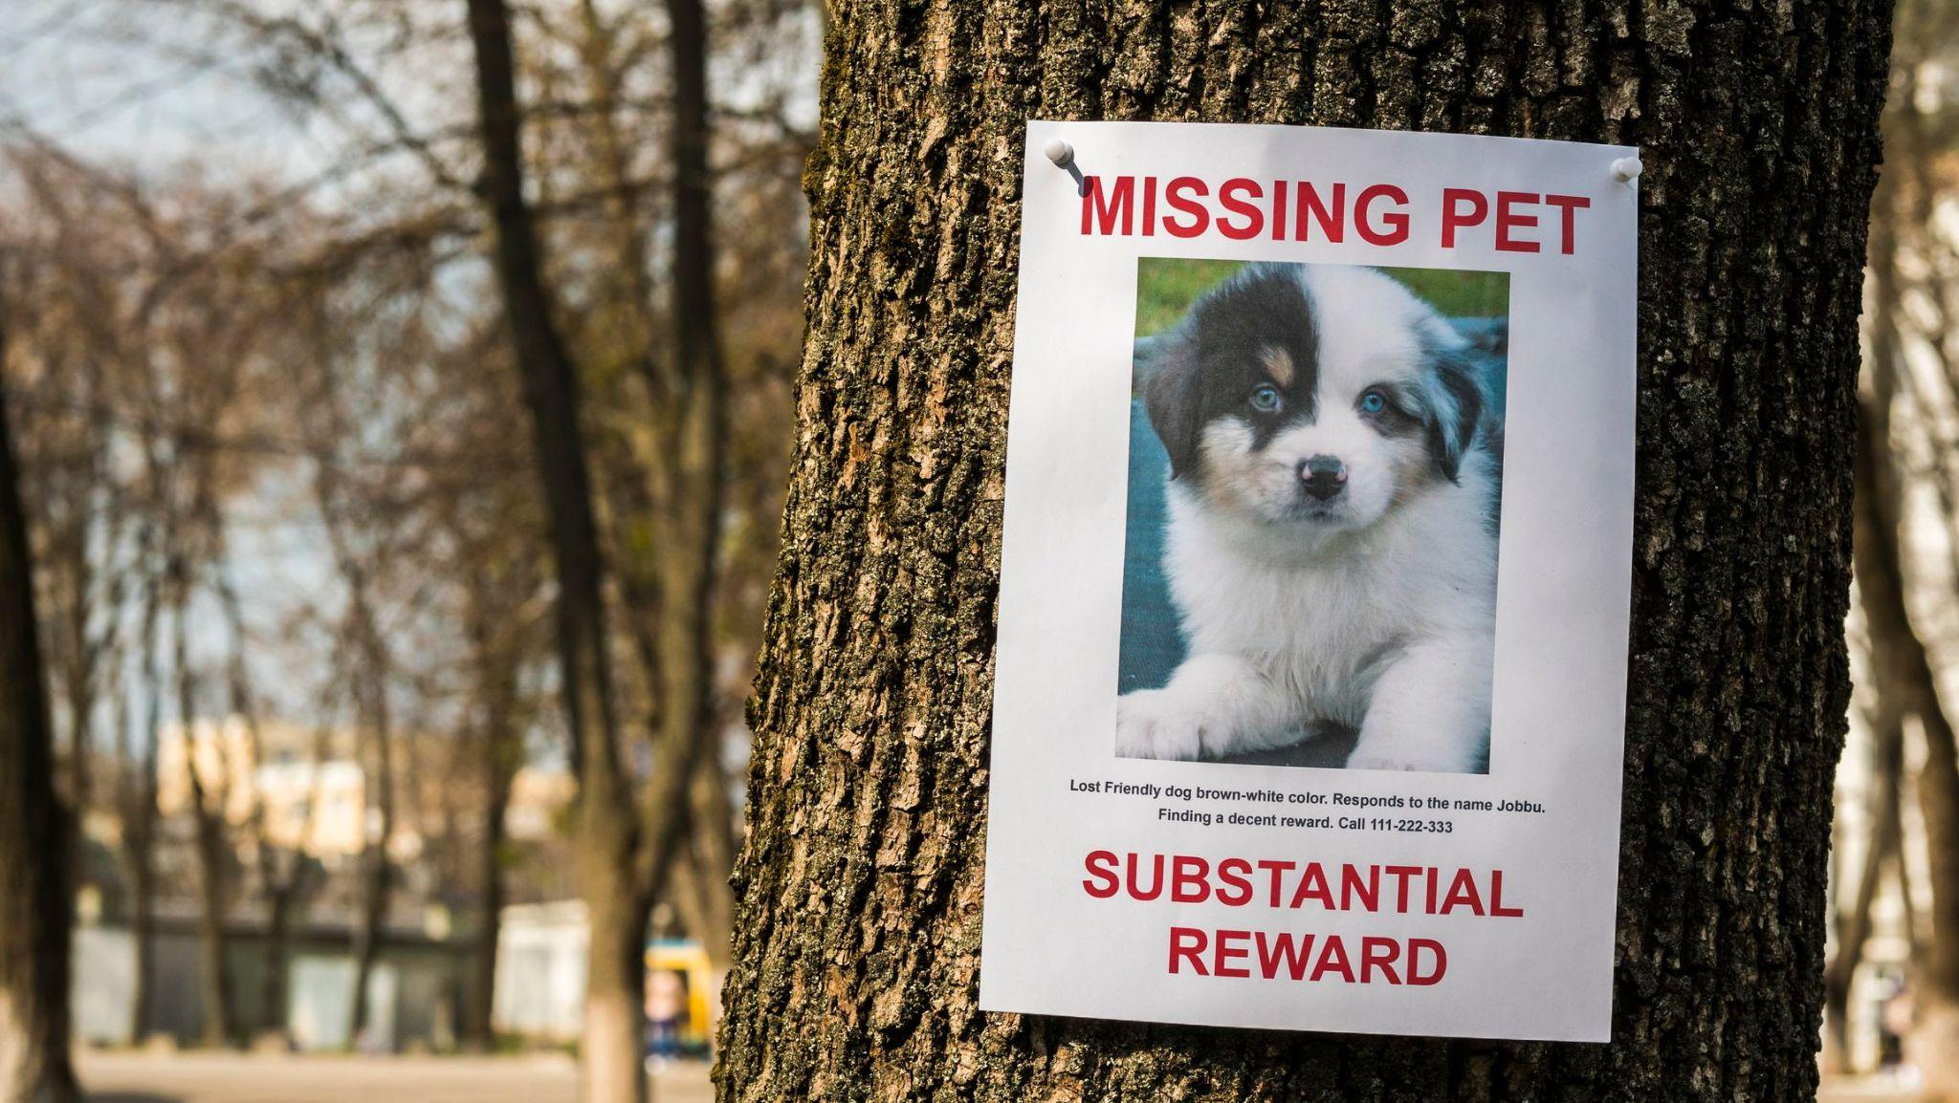
Motivation
predict future behavior
Improving the accuracy of the model for classifying dog breeds can have positive impacts on the care and training of dogs, as well as contribute to the advancement of machine learning algorithms beyond just dog breed identification.
know what medical problems to watch for
Notes:
Future dog owners can anticipate how big the pup will be and what he will look like. On the other hand, knowing the breed in and out, you can know what medical problems to watch for.

Slide 6
02
Dataset

Slide 7
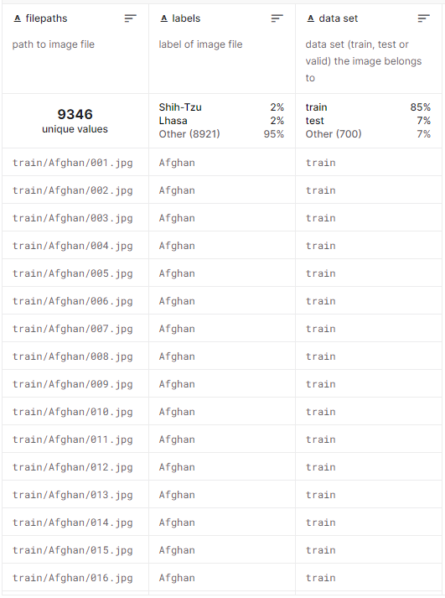
Dataset
Publicly Available on Kaggle.com
~8000 Train, 700 Test, 700 Validation
224x224x3 px
70 Prelabeled Classes
https://www.kaggle.com/datasets/gpiosenka/70-dog-breedsimage-data-set

Slide 8
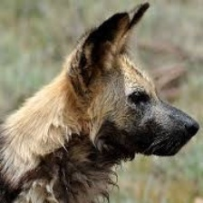
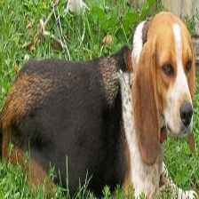
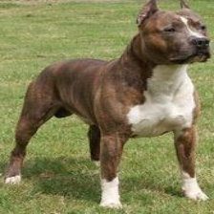
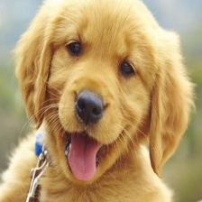
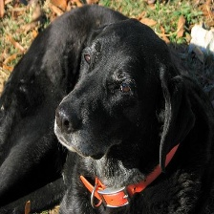
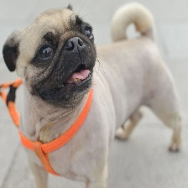
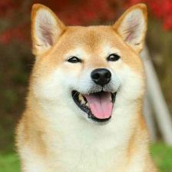
Examples
African Wild Dog
Beagle
Beagle
Boxer
Golden Retriever
Labrador
Pug
Shiba Inu

Slide 9
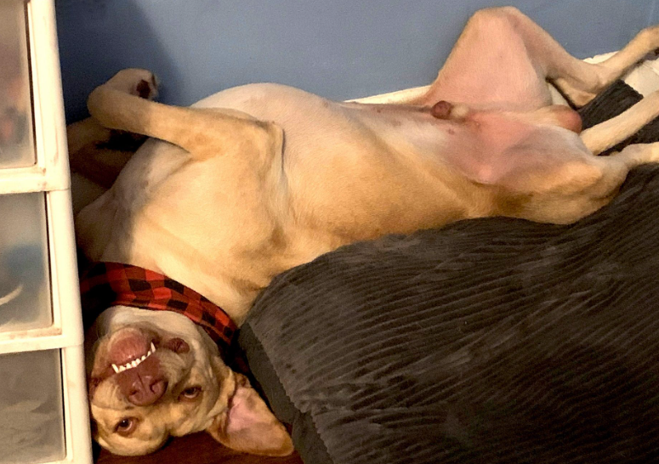
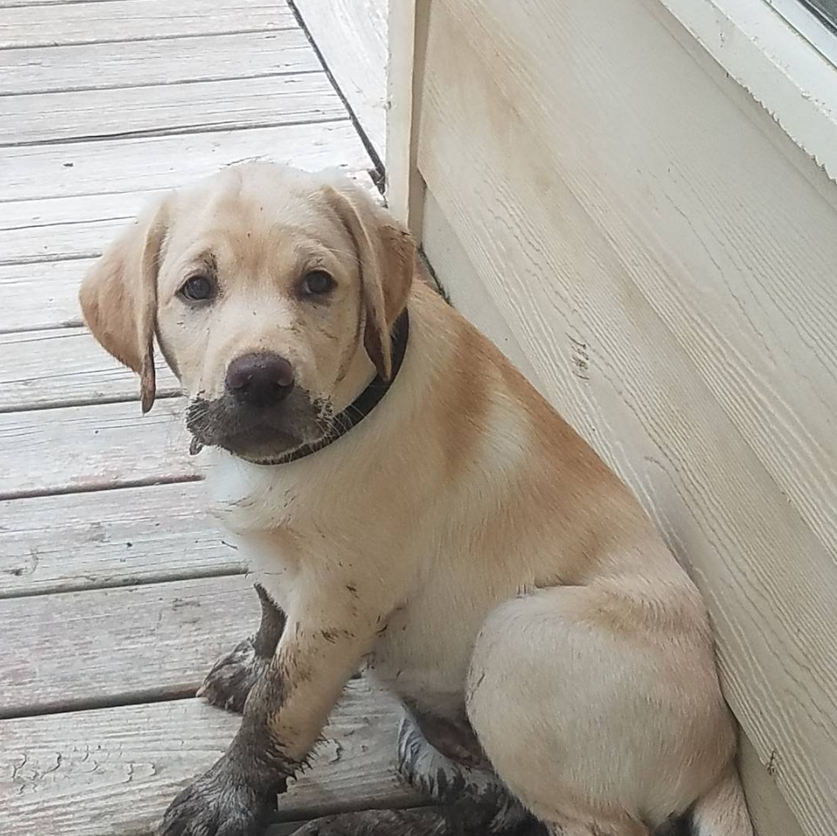
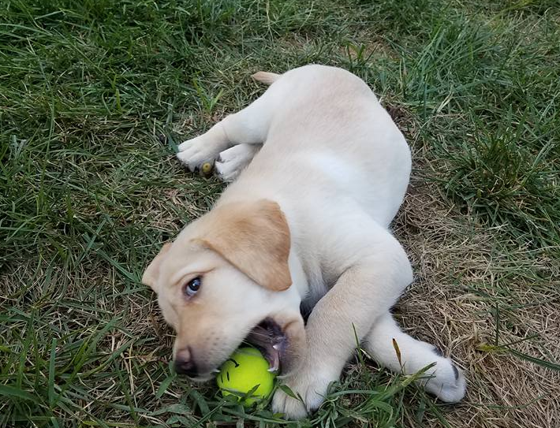
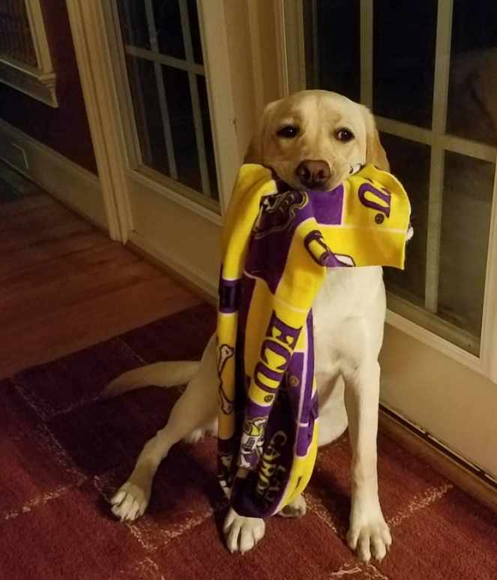
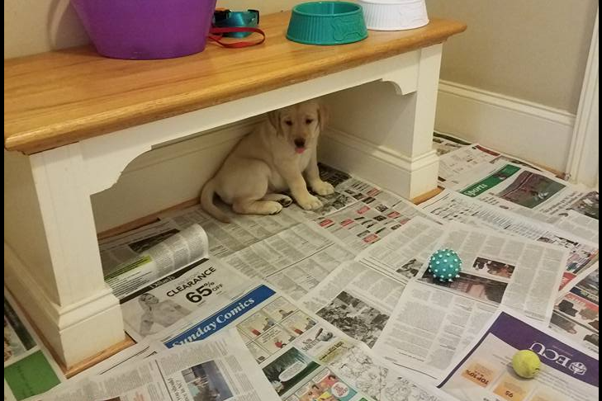
What are the downfalls?
Limited Positions
Lighting Consistency
Limited Obstructions

Slide 10
03
Methodology

Slide 11
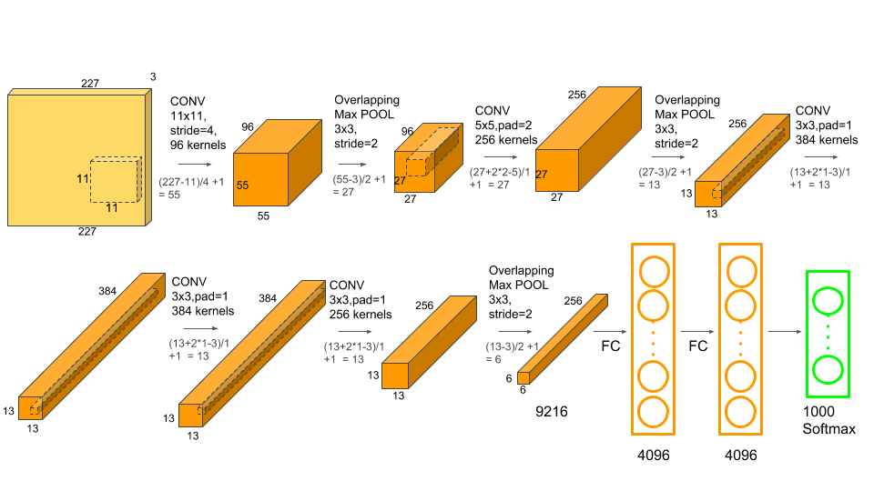
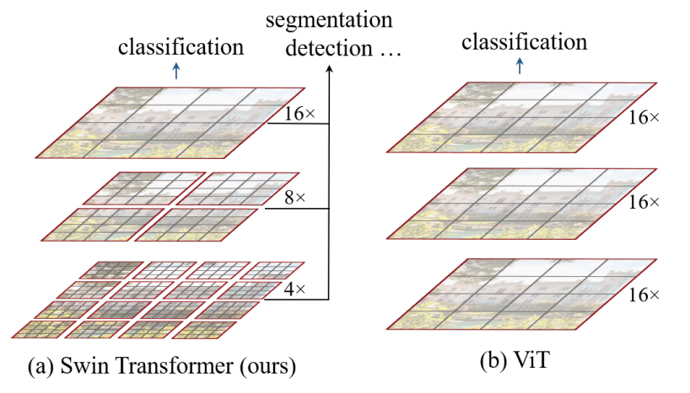
Methodology
We conducted experiments on the dog breed dataset using Alexnet and Swin Tiny Transformer.
AlexNet is a convolutional neural network that is 8 layers deep with 62 million parameters.
The Swin Tiny Transformer (Vision Transformer) has 28 million parameters.
Swin constructs hierarchical feature maps by merging patches from the image.
Perform downsampling by patch merging: concatenate over channels
Previous Vision Transformers produced feature maps of one resolution
Computation complexity was greater for previous Vision Transformers, due to computing self-attention globally.

Slide 12
Methodology
Optimizer: Final choice was SGD, but we did try RMSprop.
Low learning rate with a decay factor.
Fine Tuned the classification layers: prerequisite layers did not benefit from fine tuning.
Trained for a limited number of epochs
Data augmentation: Random resized crop and horizontal flip, data normalization
Small batch size: noise in gradient information and difficulty generalizing to new data.

Slide 13
04
Results

Slide 14
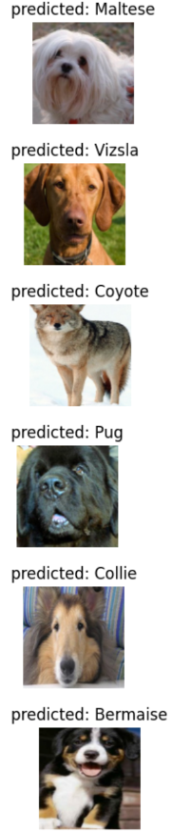
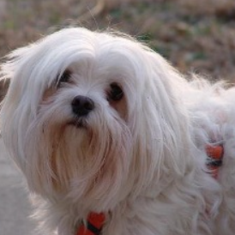
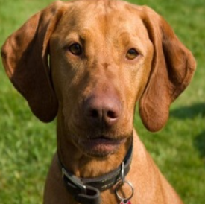
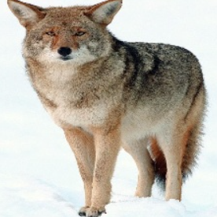
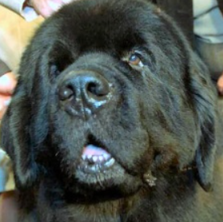
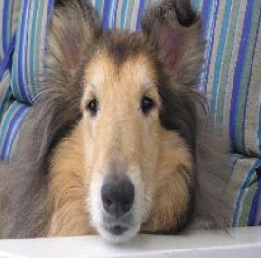
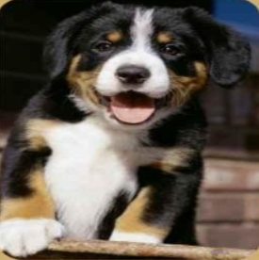
Results
AlexNet Accuracy: 0.8571 (Lr=0.001, Momentum=0.9, Dropout=0.1(every 7 epochs), 20 total epochs)
Swin-T Transformer Accuracy: 0.9643 (Lr=0.001, Momentum=0.9, Dropout=0.1(every 7 epochs), 10 total epochs)
As can be seen from the accuracies, Swin-T Transformer performed the best as expected.
Ground Truth:
Maltese Vizsla Coyote Newfoundland Collie Bermaise

Slide 15
05
Conclusion

Slide 16
Conclusion
Fine-tuned AlexNet and Swin-T Transformer for classification on 70 dog breeds
Swin-T outperformed AlexNet, achieving an accuracy of 96 percent compared to AlexNet’s 85 percent
Our project showcases the effectiveness of deep learning models for image classification
This demo provides reference when performing classification tasks using pre-trained models on any future projects

Slide 17
06
Q&A

